Slide 1
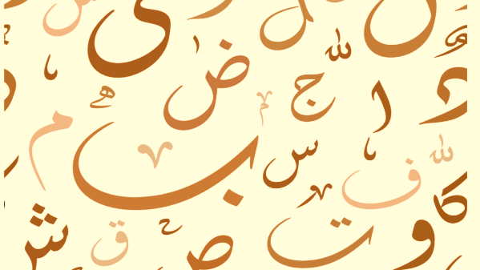

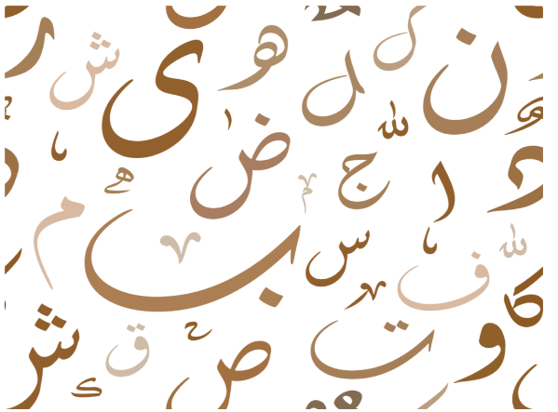
Handwritten Arabic character recognition Using Deep Learning
Data Science project

Slide 2

Recently, Arabic handwritten characters recognition has been an important area due to its applications in several fields. This work is focusing on the recognition part of handwritten Arabic characters recognition that face several challenges, including the unlimited variation in human handwriting and the large public databases.
Introduction

Slide 3

Our Dataset From Kaggle .
The Dataset is composed of 16,800 Images characters.
A training set(13,440 characters to 480 images).
A test set (3,360 characters to 120 images).
Dataset

Slide 4
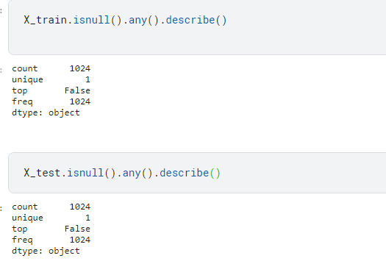
Data preprocessing
(There is no Null Value in Our Data and it's Cleaning Already)

Slide 5

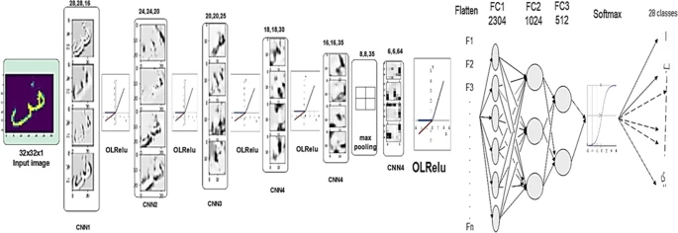
CNN Model
We built our Model Using convolution neural networks(CNN) The reason of choosing it our dataset are images .
Max pooling with (2x2) filter and stride.
Flatten to converting the dataset into a 1-D array.
Fully connected layer and output layer 2 Relus and last one is softmax .
Model
Fig1 :Explain the working of CNN

Slide 6
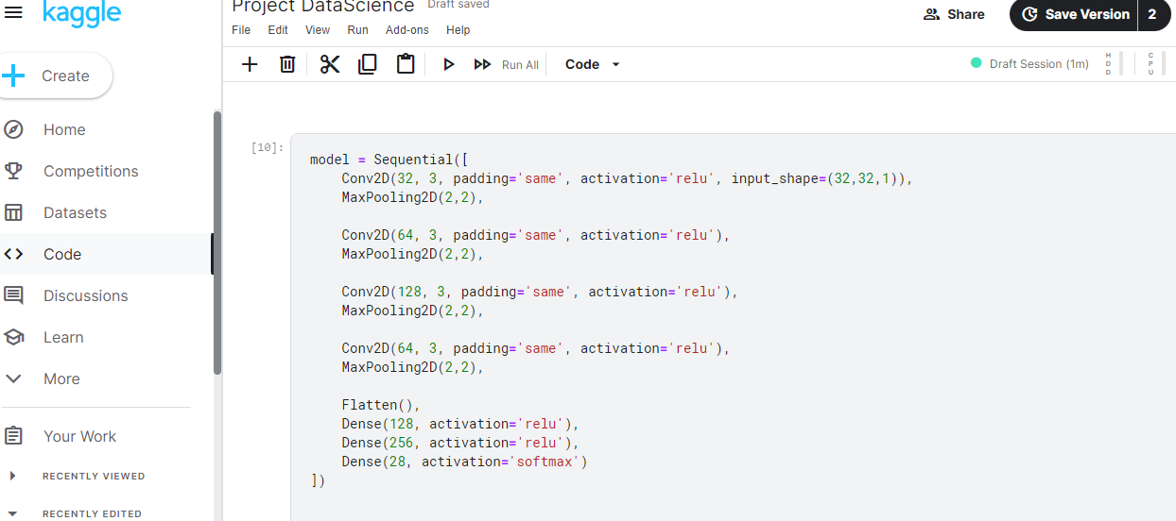
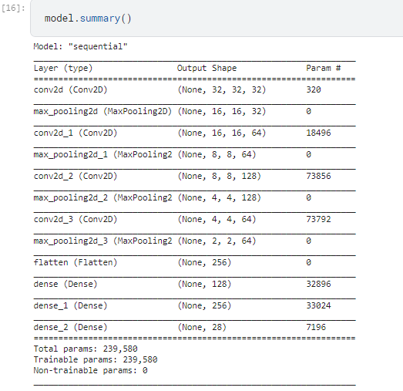
Model

Slide 7
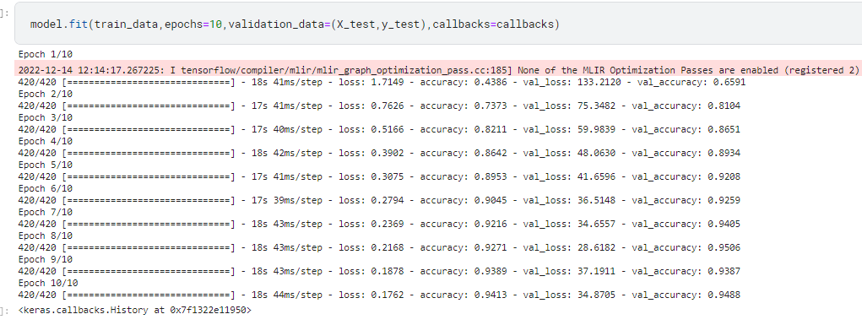


Step 1 - Compile CNN model
Step 2 – Fit CNN model
When we Fit our model in 10 epochs, we got This .
Result 1

Slide 8
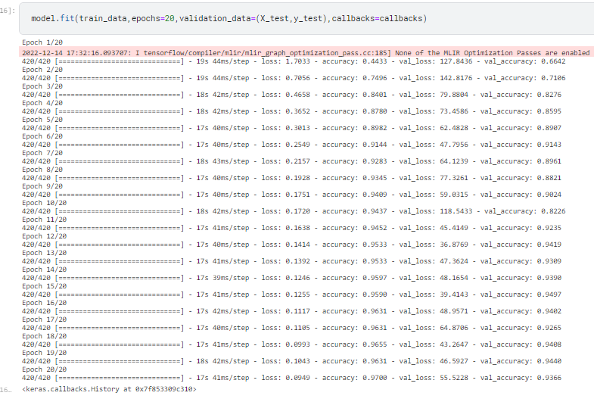

Step 2 – Fit CNN model
When we Fit our model in 20 epochs, we got This .
Result 2

Slide 9
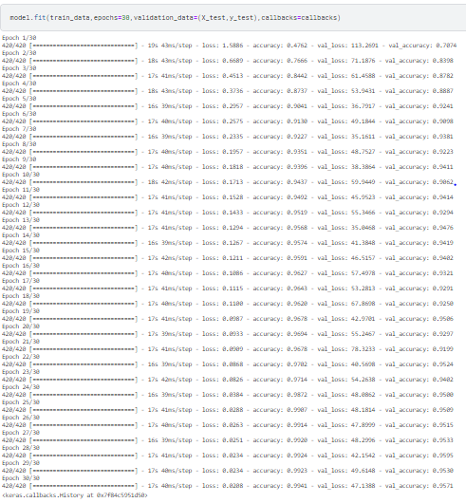

Step 2 – Fit CNN model
When we Fit our model in 30 epochs, we got This .
Result 3

Slide 10
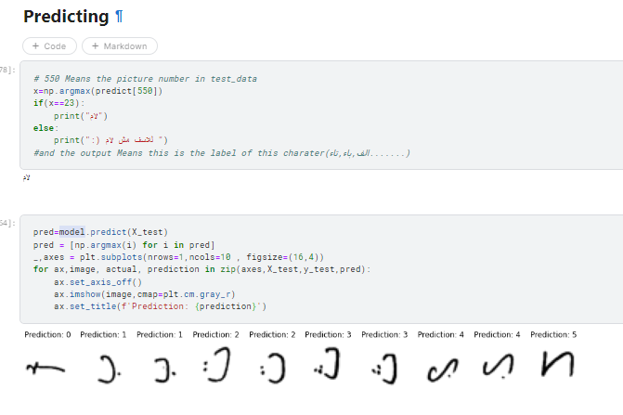
Predict Vs Actual .
Result 4

Slide 11


Accuracy.
Accuracy
Accuracy For Testing = 96.64%

Slide 12
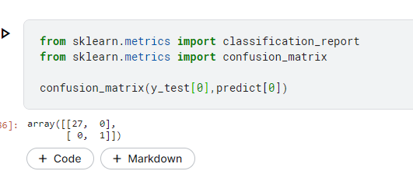
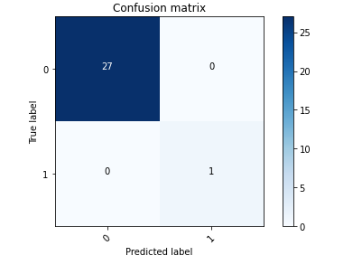
This Confusion Matrix For Handle one predicted Character
Confusion Matrix

Slide 13
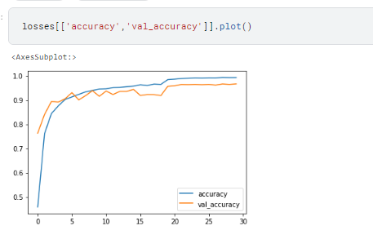
Accuracy Vs Val_Accuracy.
Conclusion
Train : blue line
Test : yellow line

Slide 14
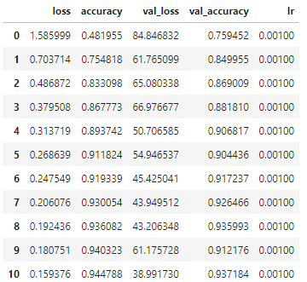
Table
Conclusion

Slide 15

Thanks

